Slide 1
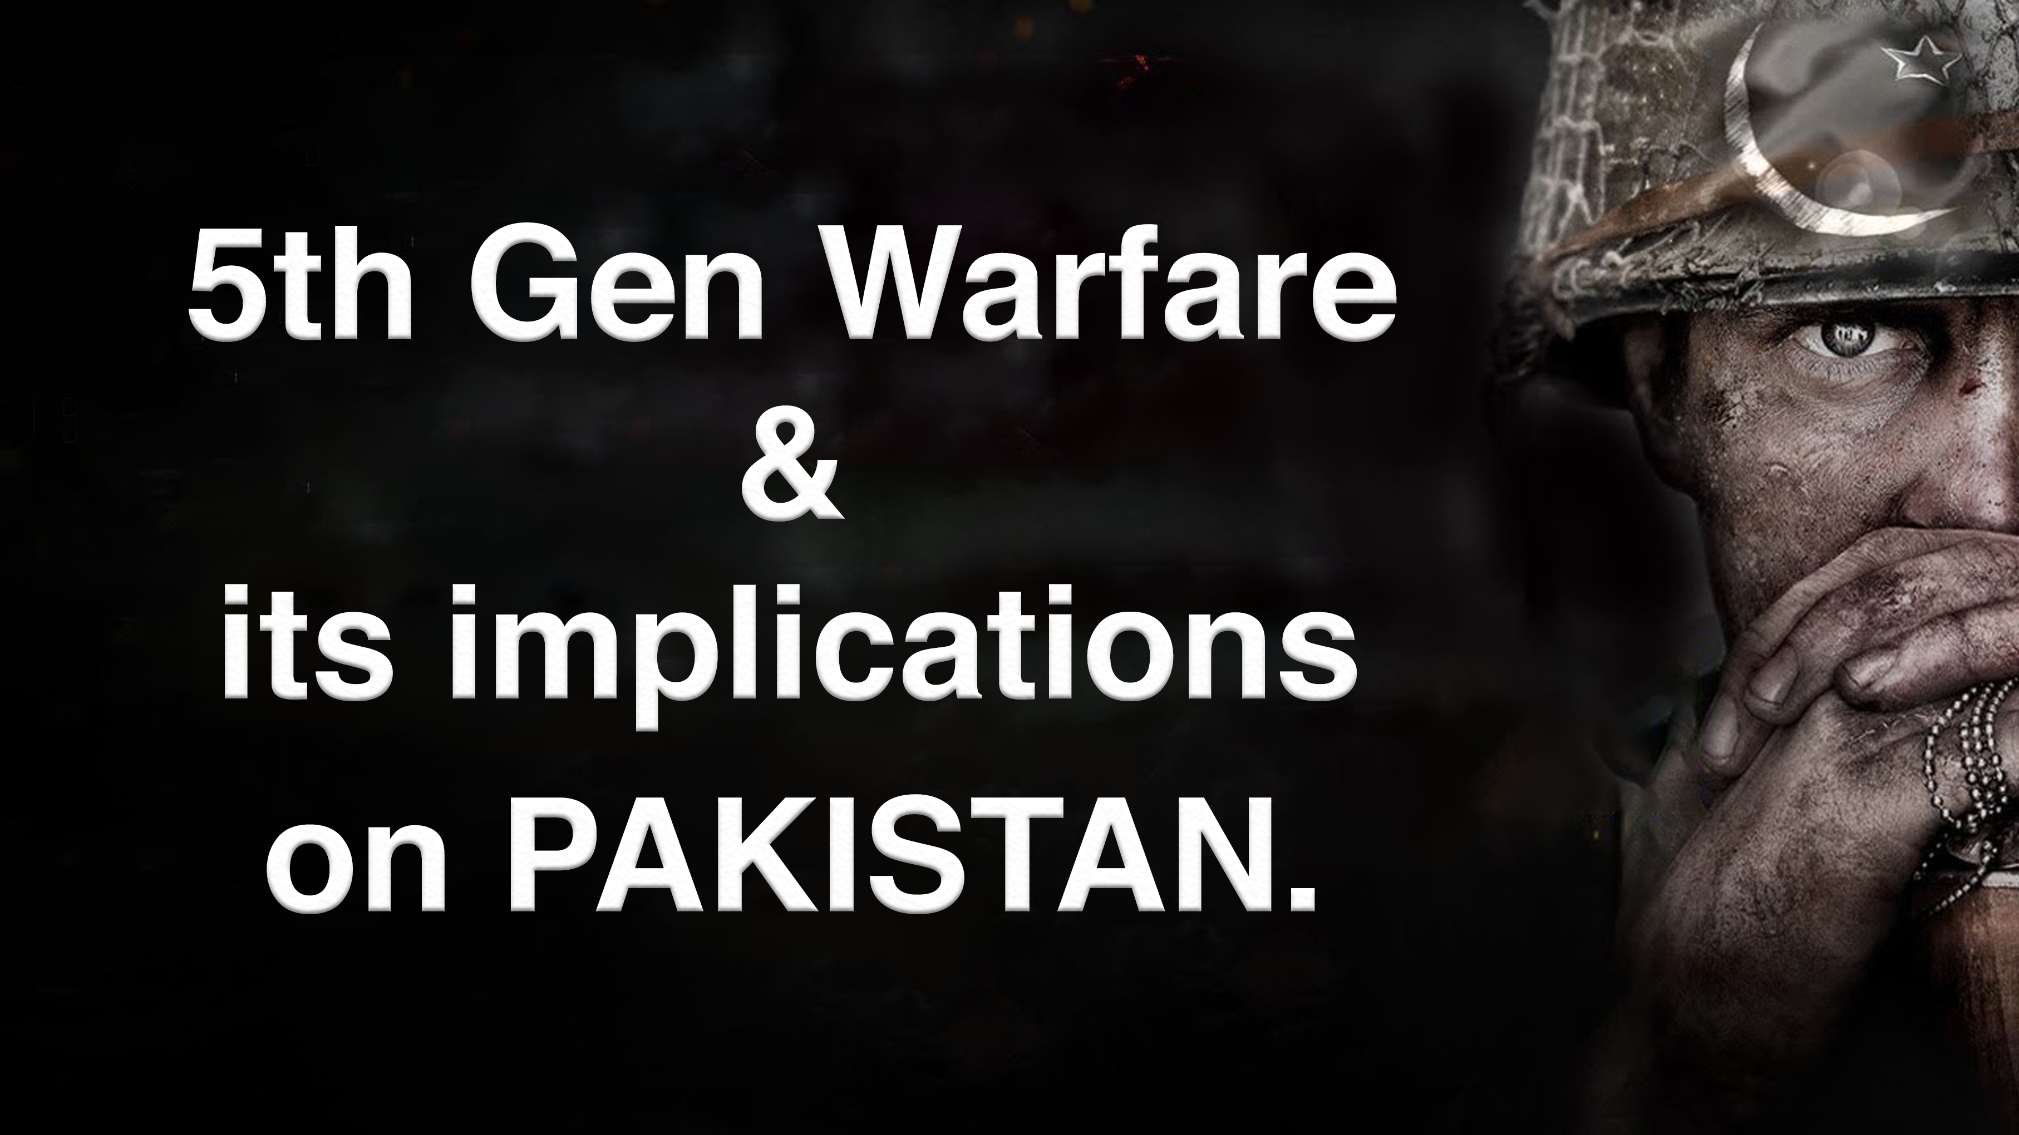

Slide 2



What is 5G Warfare?
War of Digital Medium
Fake News
Fake Websites
Targeted social Media campaigns

Slide 3
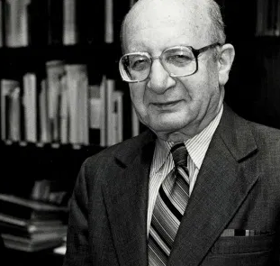
How it all began?
Participated in the UNHRC session in 2007 and 2011
Criticized Pakistan for its human rights abuses.
Had already died in 2006
THEN WHO PARTICIPATED IN THOSE EVENTS???
Prof. Louis B Sohn
Human Rights Activist

Slide 4

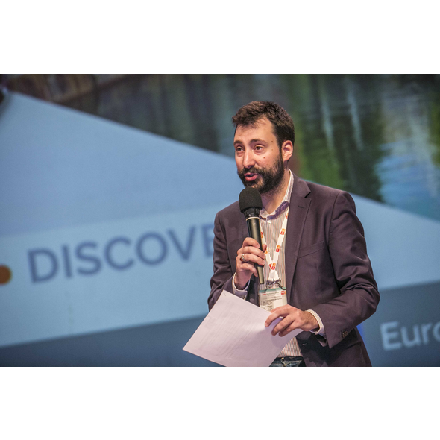
EU Dis-Information Lab
A watchdog which monitors and exposes global
Propaganda campaigns against targeted groups.
Started investigating Prof. Louis B Sohn’s resurrection.
Published the report “Indian Chronicles” in Dec 2020.
Exposed a propaganda network working for the past
15 years.
Alexandre Alaphilippe
Executive Director of Eu Dis-info Lab

Slide 5
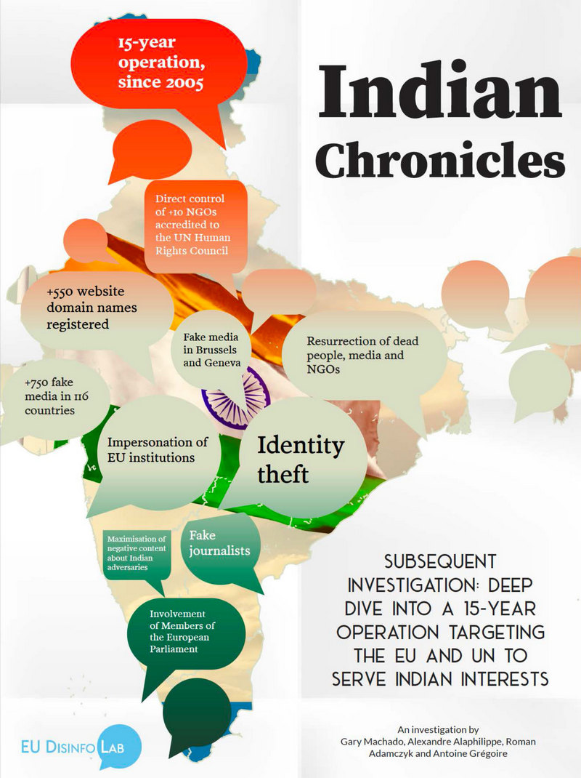
THE INDIAN CHRONICLES, 2020
Fake Media in Brussels
and Geneva
550+ Domain fake
names registered
All with one single GOAL,
“TO DISCREDIT PAKISTAN”.
Identity Theft
Resurrection of dead
people and NGOs

Slide 6
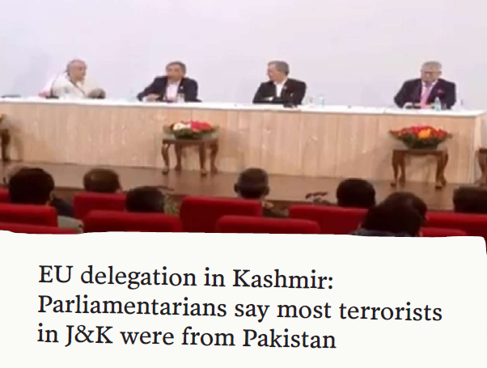
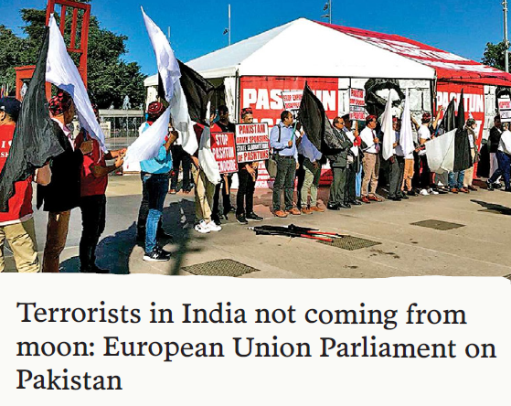
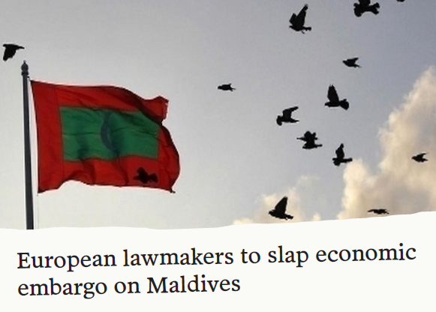
LOBBYING IN BRUSSELS (EU Head Office)
Fake media outlets reported Private trips as official visits of European Members of Parliament
and miss-quoted statements.
Convered by: DNA Media Group
FACT: Not an official delegation
Convered by: DNA Media Group
FACT : Statement by a Single MEP
Convered by: ANI Media Group
FACT : Henri Malosse exaggerating
his authority.

Slide 7
THAT’S NOT ALL…. A BIG/COPY PASTE NETWORK
THE ROLE OF ANI NEWS AGENCY: REPACKAGING AND AMPLIFYING CONTENT PRODUCED
IN BRUSSELS AND GENEVA
ANI owned about 450 ‘self-proclaimed’ news outlets which basically copy-pasted the content
generated with the help of Fake NGOs in UN (Geneva) and EU Parliament (Brussels).

Slide 8
SRIVASTAVA GROUP: The culprit pulling strings behind the curtain

Slide 11
FAKE NETWORK OF NGOs in EU AND UN
EU Dis-info Lab found out 10 UN accredited NGOs directly controlled by
Srivastva Group.
All 10 NGOs had the following traits in common:
They were resurrected from the ashes of real NGOs.
Discredited Pakistan in the UN and EU and promoted Indian interests
in UN meetings regarding important matters.

Slide 12
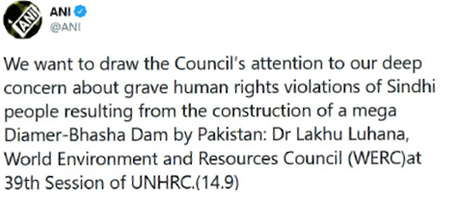
CASE STUDY I
World Environment and Resources Council(WERC):
Founded in 1970s to promote, “Sciences of
Environmental importance”.
Ceased to exist in late 90s.
Hijacked by Indian chronicles in 2005 and
representatives from this NGO participated
in UN sessions.
Did false propaganda on Baloch and
Sindhi genocide and discredited Pakistan
on the international stage.
ANI News Agency spreading the
propaganda of fake NGOs.

Slide 13
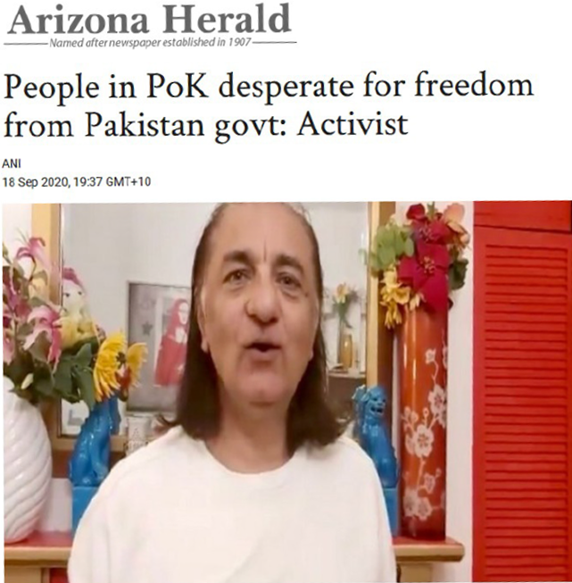
CASE STUDY II
CENTER FOR ENVIRONMENTAL AND MANAGEMENT STUDIES(CEMS) :
Originally formed in New Delhi in 1980s.
Stopped its activities in 1986.
Emerged again on the international stage in
Jan, 2016 this time hosted under the same network
of NGOs whose IP addresses were owned
by Srivastva group.
Headed by “Amjab Ayb Mirza”.
Propagated Indian stance on Kashmir issue
and accused Pakistan of terror financing
in Kashmir.
Arizona Herald: another media
outlet owned by Srivastva group

